Slide 1
General Comment No. 26
Kartik, Bach and Aniva
Members of the UN Children’s Advisory Team (CAT)
Notes:
Aniva

Slide 2
Table of Contents
1
2
3
Children’s Environmental Rights
Introduction to the
UN CAT
General Comment No.26
Notes:
Bach

Slide 3
1
Who We Are
Notes:
Kartik

Slide 4
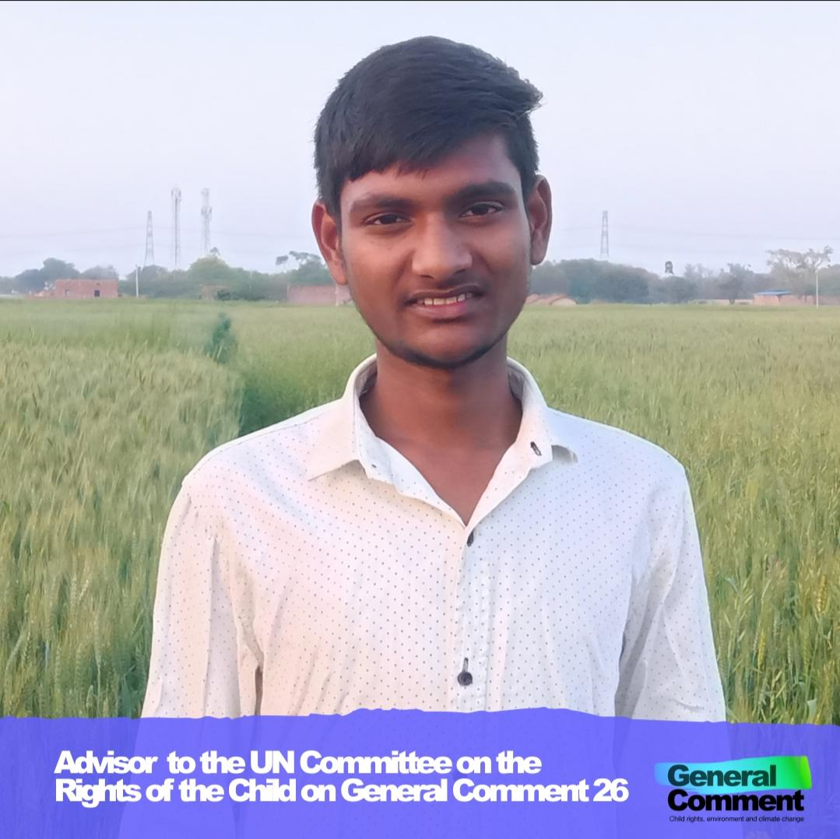
Meet Kartik!
• Founder of Knowledge For Nature campaign.
• Ambassador at Global Conscience World and Global Youth Peace Accord.
Notes:
Kartik

Slide 5

Meet Bach!
Mentor for youths that want to establish GIN Council
Founder of End Single-use Plastics Vietnam (ESUPvn)
President of Global Issues Network (GIN) Council
GIN Saigon Conference (2022, Chair); (2021, Vice-chair)
Notes:
Bach

Slide 6

Meet Aniva!
Founder of Samoan youth environment group called the ‘Eco-Toa Club’
Founder of regional level of the Eco-Toa Club called ‘Eco-Toa Pacific’
Member of youth advisory board for CRIN (Children’s Rights International Network)
Mentor for Pacific youth environmentalists
Notes:
Aniva

Slide 7

2
General Comment No. 26
Notes:
Kartik

Slide 8
What is General Comment No. 26?
Under the Convention on the Rights of the Child (UNCRC) which is determined by the Committee on the Rights of the Child
A guide to the governments of the 196 countries
Outlining how governments must uphold children’s environmental and climate rights to a healthy environment
Notes:
Kartik

Slide 9
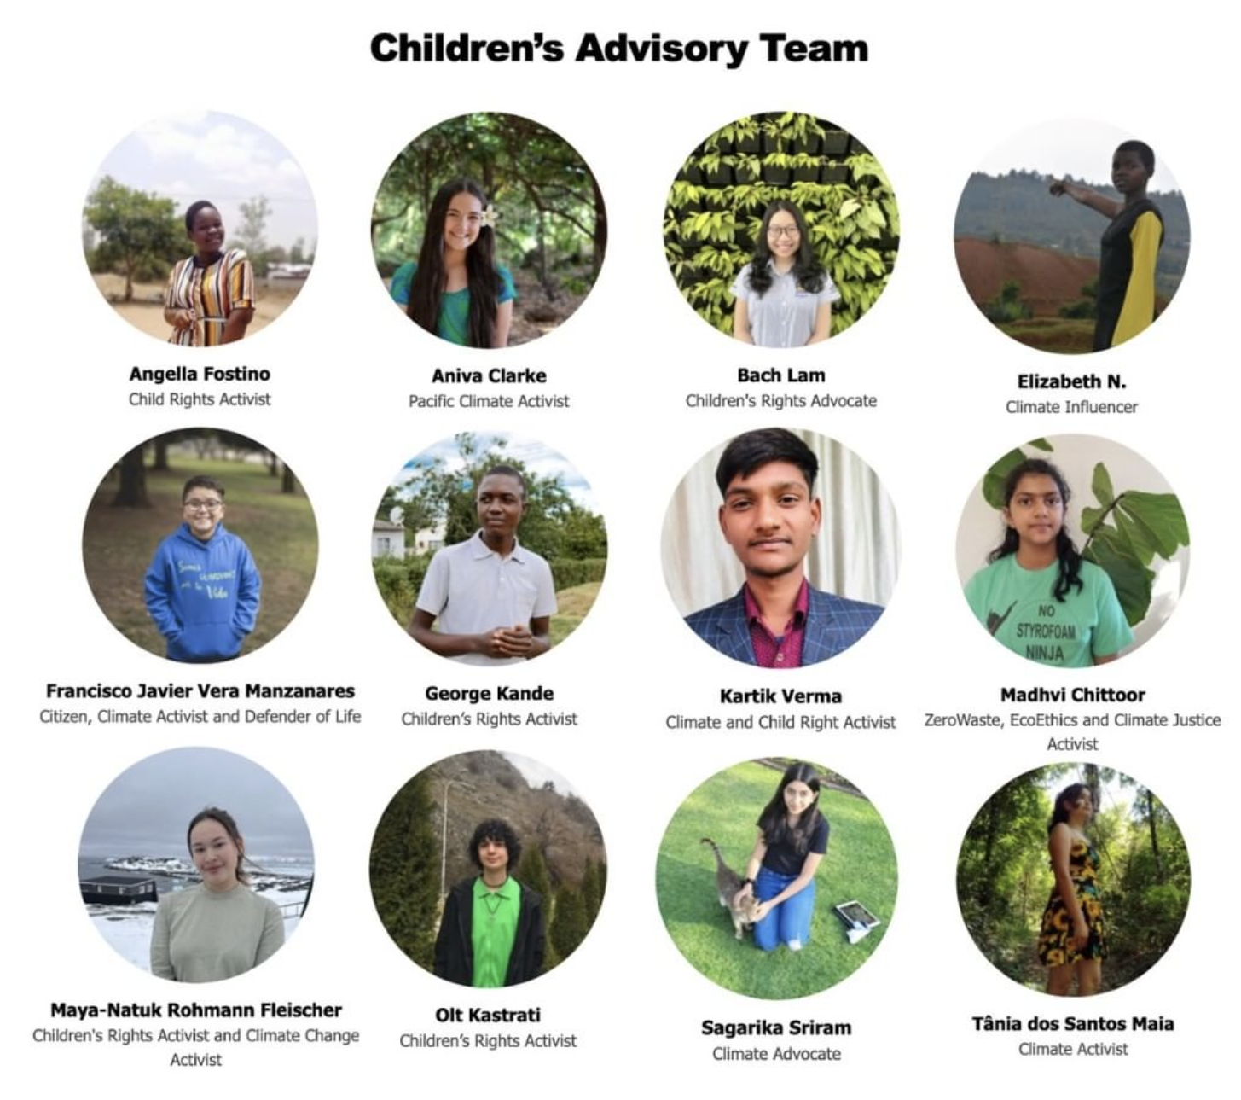
What is the Children’s Advisory Team?
We 13 young people specialising in environmental work from across the world
We are helping guide the UN Child Rights Committee in building and spreading awareness to General Comment No. 26.
Notes:
Bach

Slide 10
Where the CAT are from
The rest of the CAT members
CAT members from the Asia & Pacific region
Notes:
Aniva

Slide 11
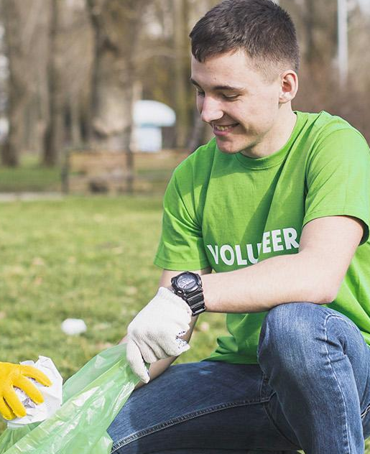
Other events relating to GC 26:
COP 27 (2022)
Ocean Day (9th June)
Stockholm 50+ (2nd-3rd June)
GC 26 Questionnaire (until 30th June)
Notes:
Kartik
Aniva: Link to questionnaire- https://l4cqlef9g5g.typeform.com/to/jmmLTuP5?typeform-source=childrightsenvironment.org

Slide 12
What can you do to participate in GC26?
Complete the questionnaire!
Participate in the consultations about GC26 that will happen later this year
To be notified of the consultations, sign up to Child Rights Environment’s newsletter
Follow tdh Germany on social medias for the CAT’s upcoming social medias
Notes:
Bach
Link to sign up for CRE: https://childrightsenvironment.org/subscription/

Slide 13
3
Children’s Environmental Rights
Notes:
Aniva

Slide 14
Consequences of Climate Change for Children and Youth
 | Sea ​​level Rise | Puts our land at risk of being swallowed by the surrounding ocean
 | Extreme Weather Conditions | Can lead to drought in hot areas and typhoons in coastal areas
 | Increased Natural Disasters | Destroys crops, homes and natural environments
 | Risks To The Nature | Climate change will destroy natural habitats and forests
Notes:
Aniva

Slide 15
Children’s Rights to a healthy environment
Every child has a right to a healthy environment
Children have the rights to have access to environmental justice platforms
Children’s ideas should be considered when environmental policy are made
Private sectors should take into account children’s
rights during decision making
Notes:
Kartik

Slide 16
THANK YOU FOR LISTENING!
Notes:
Together

